Slide 1
Introduction to Nanopore Sequencing
Advanced Training in Molecular Biology – MSc
Daniel Ward PhD
Notes:
I’m going to talk today about third generation sequencing technologies particularly for use in outbreak scenarios
Hopefully in this practical WE CAN BRING TOGETHER SOME OF THE skills you have learned in the different sessions and apply them here to analyse this data, whicle introducing a new sequencing platform

Slide 2
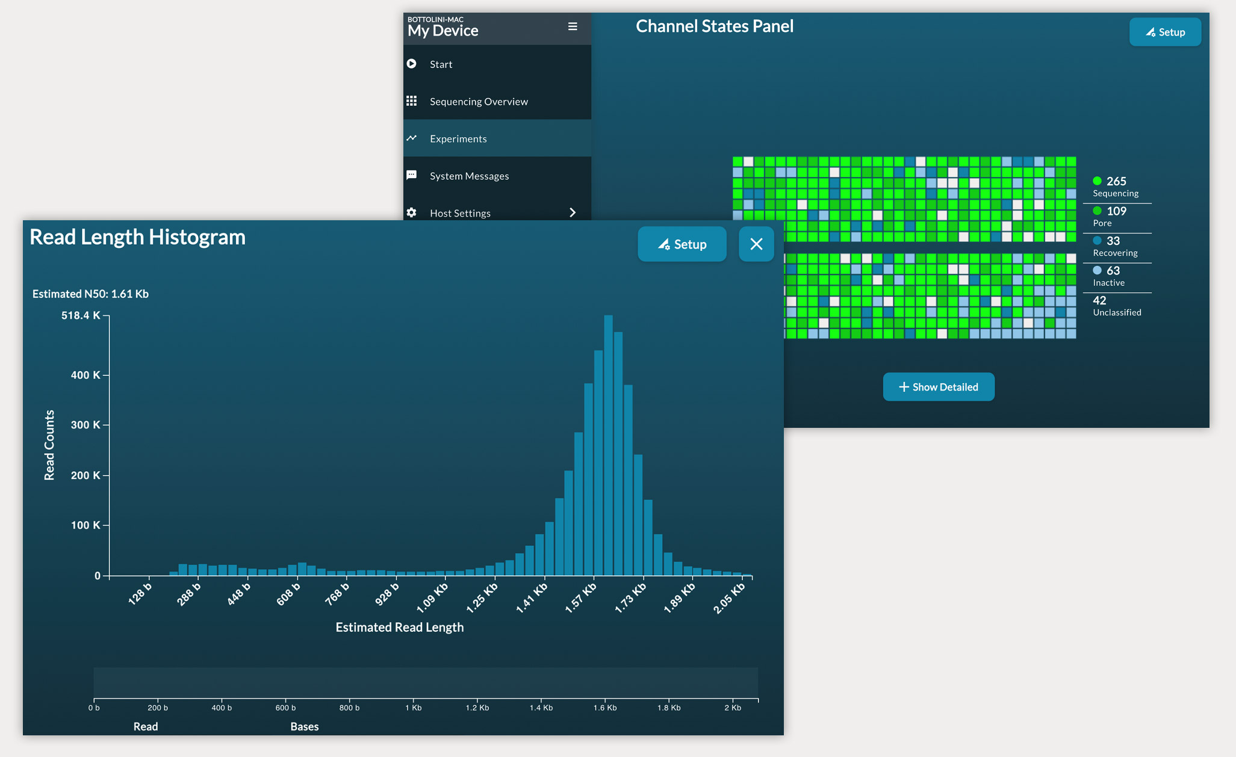
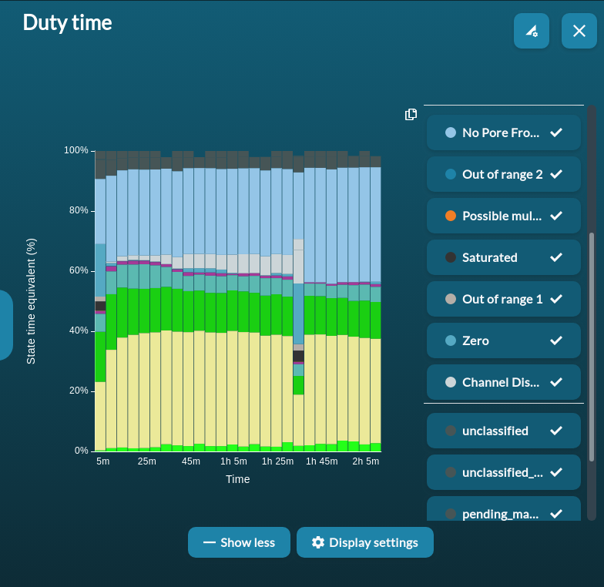
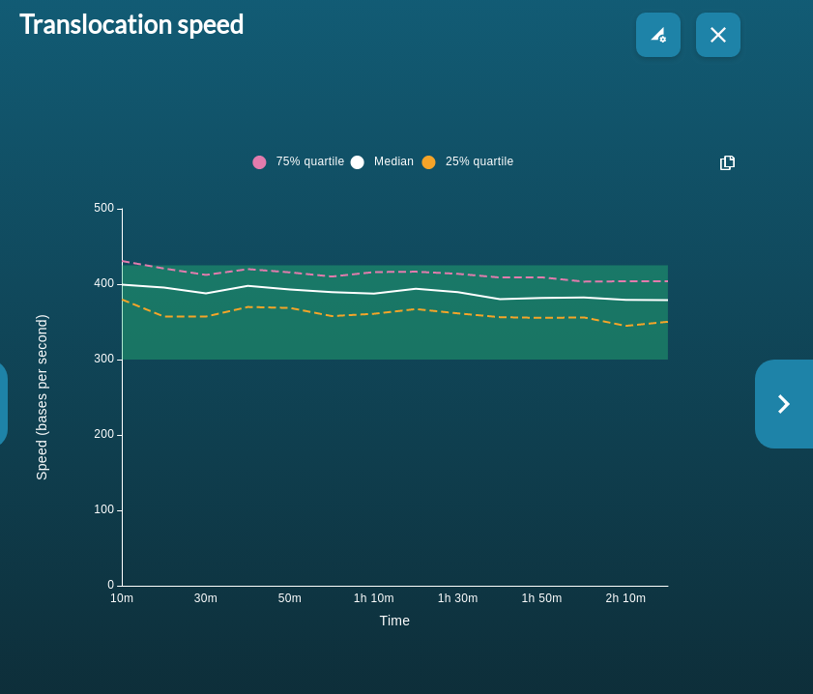

MinION run QC
Remember to save your PDF report in MinKNOW

Slide 3
Analysis Pipeline
Basecalling
Quality control
Mapping, assembly and variant calling
Converting the electrical signals generated by a DNA or RNA strand passing through the nanopore (fast5) into the corresponding base sequence of the strand (fastq).
Dorado:
Integration with MinKNOW GUI
Demultiplexing and kit selection built in
GPU optimised
The PDF from MinKNOW and tools such as pycoQC can useful in understanding metrics.
Demultiplex and adapter trimming (Guppy or Porechop)
Removal of contaminant reads (Kraken and centrifuge)
Quality filtering (Guppy and Filtlong)
Different requirements for mapping or assembly.
There are specialised tools for assembling and mapping nanopore reads.
Mapping:
Minimap2 (-ax map-ont)
BWA (-x ont2d)
Assembly:
Flye
Unicycler
SPAdes
Canu

Slide 4
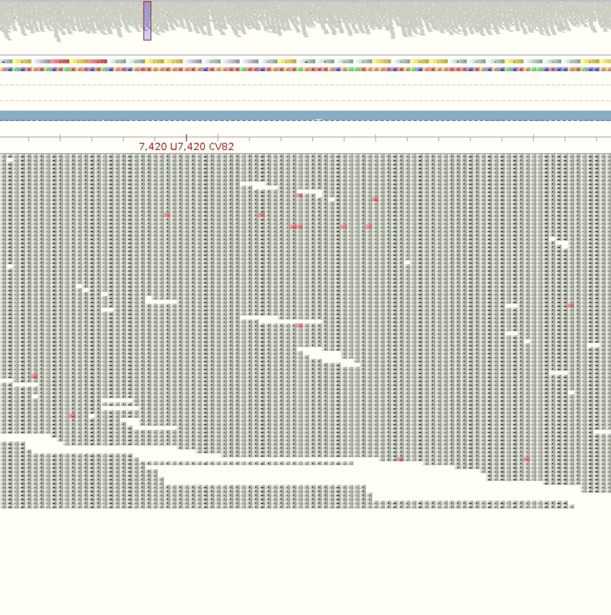
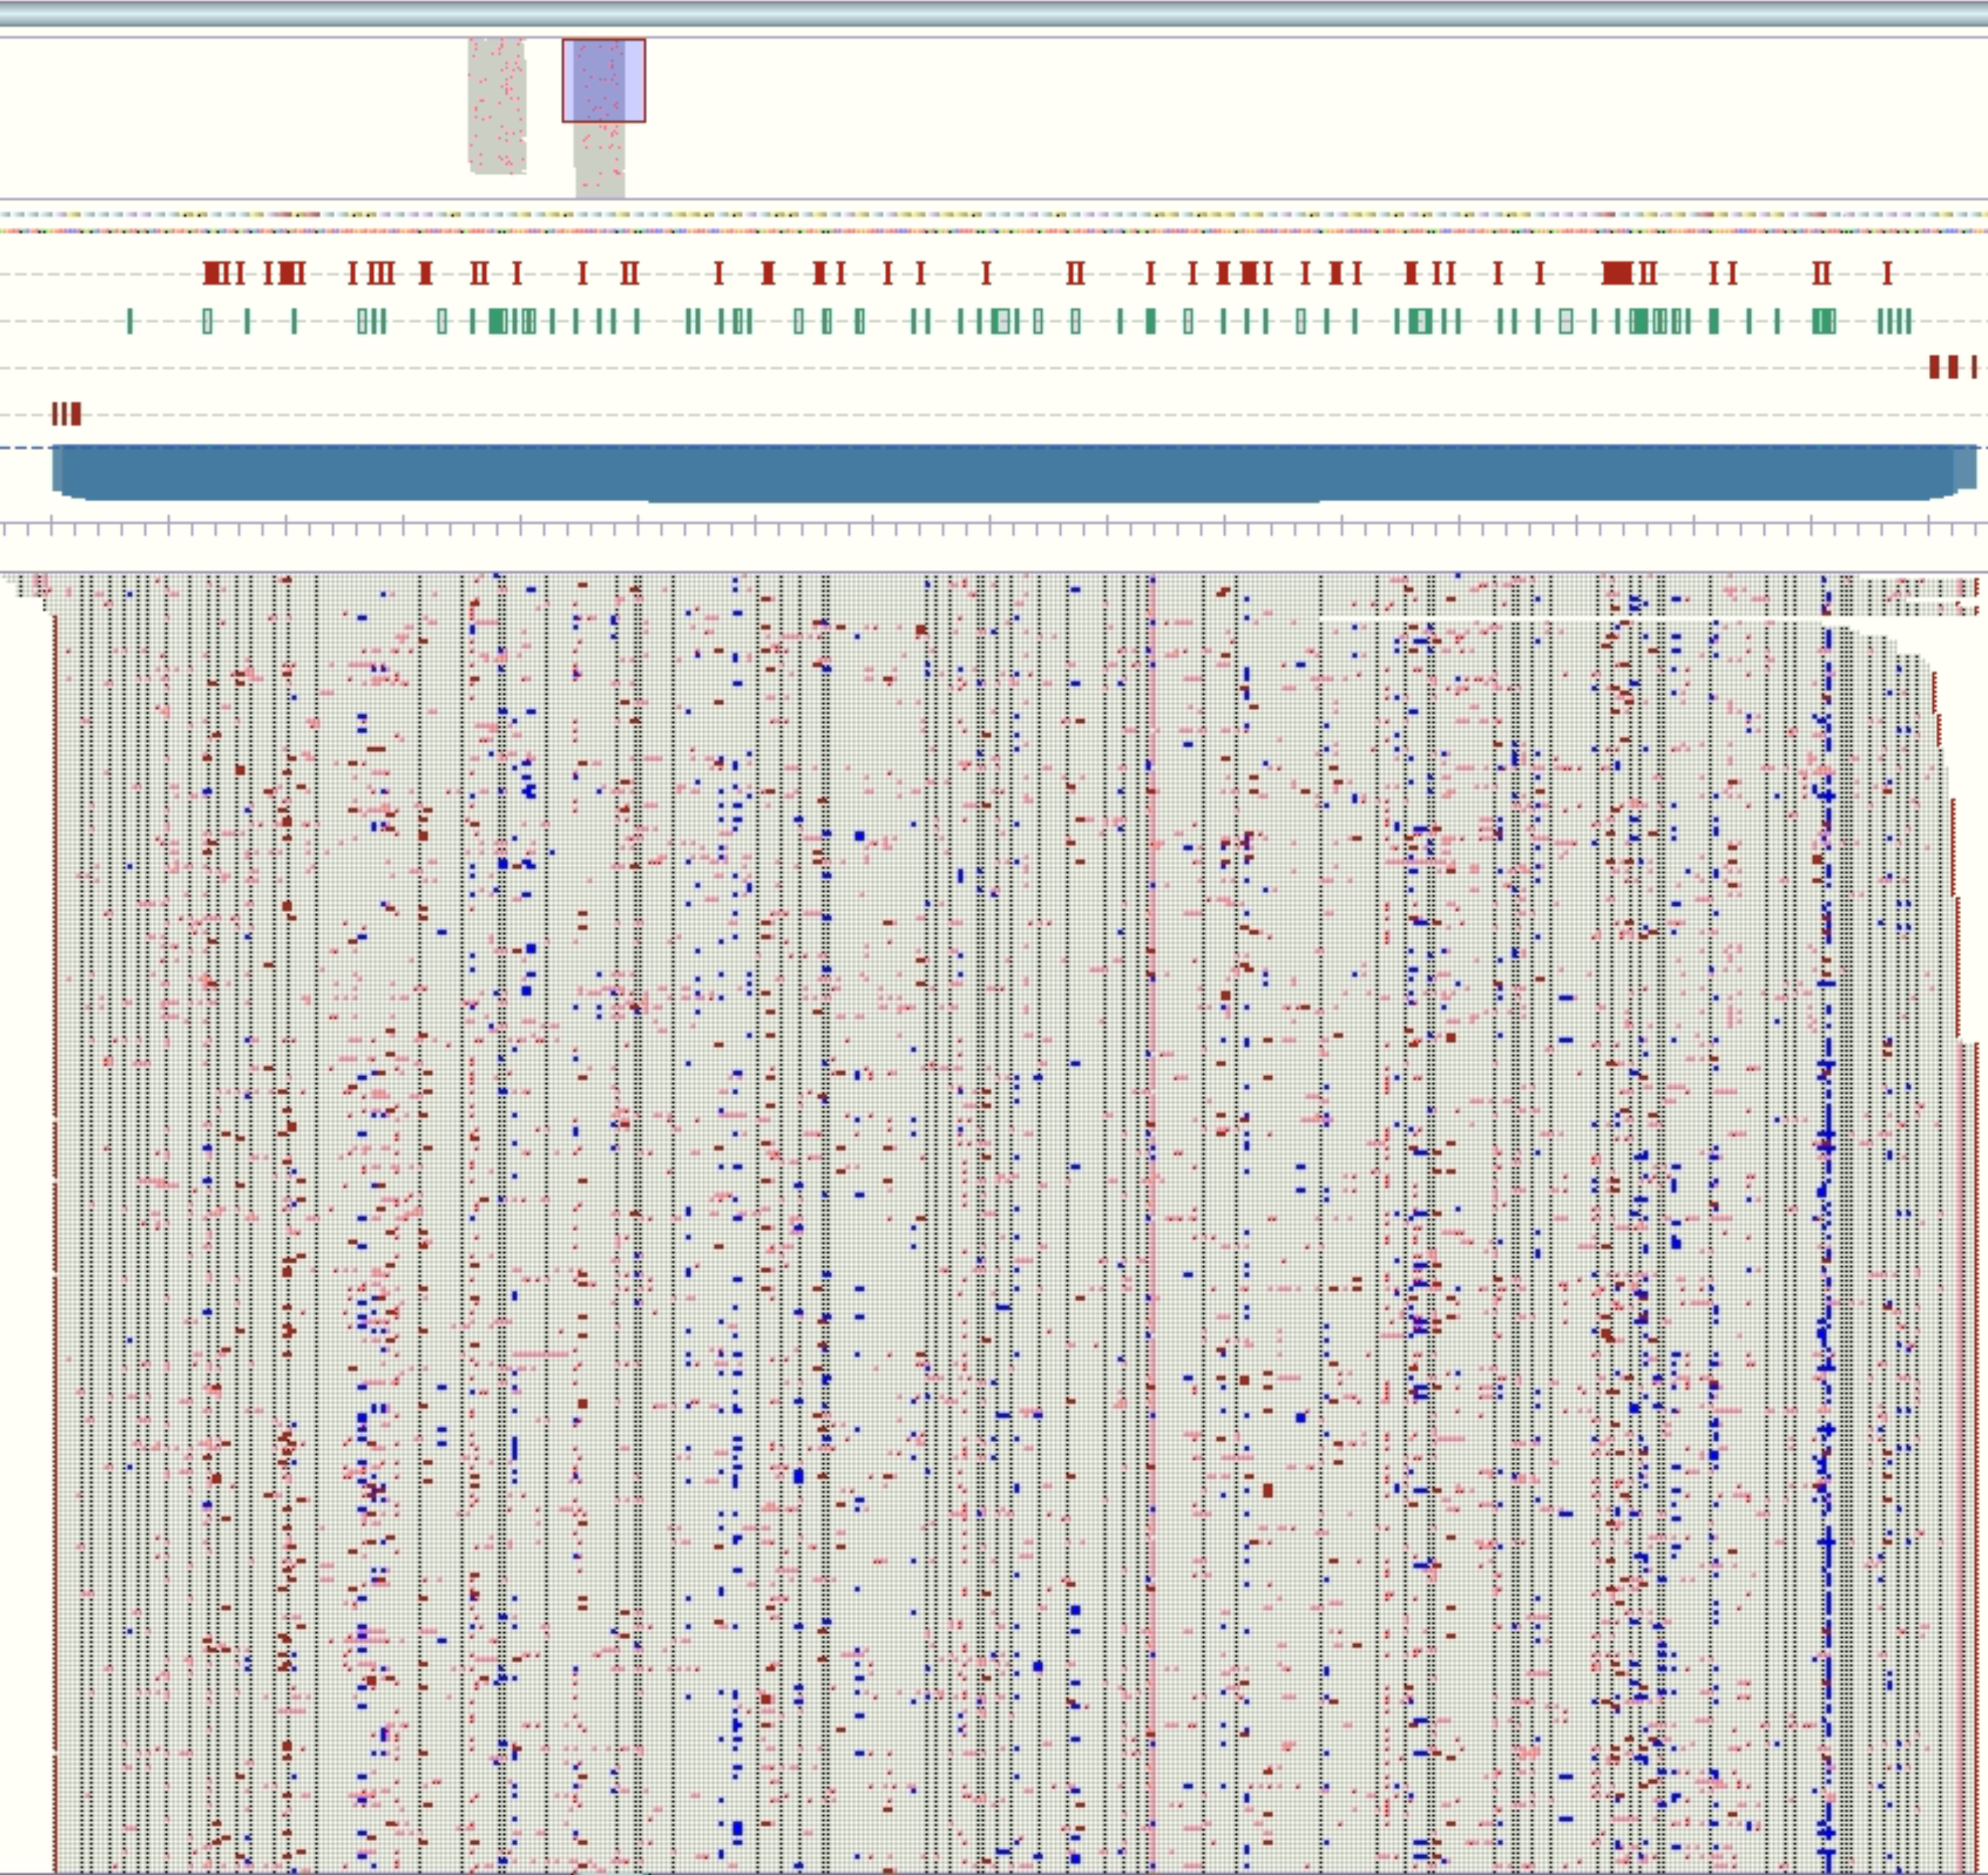
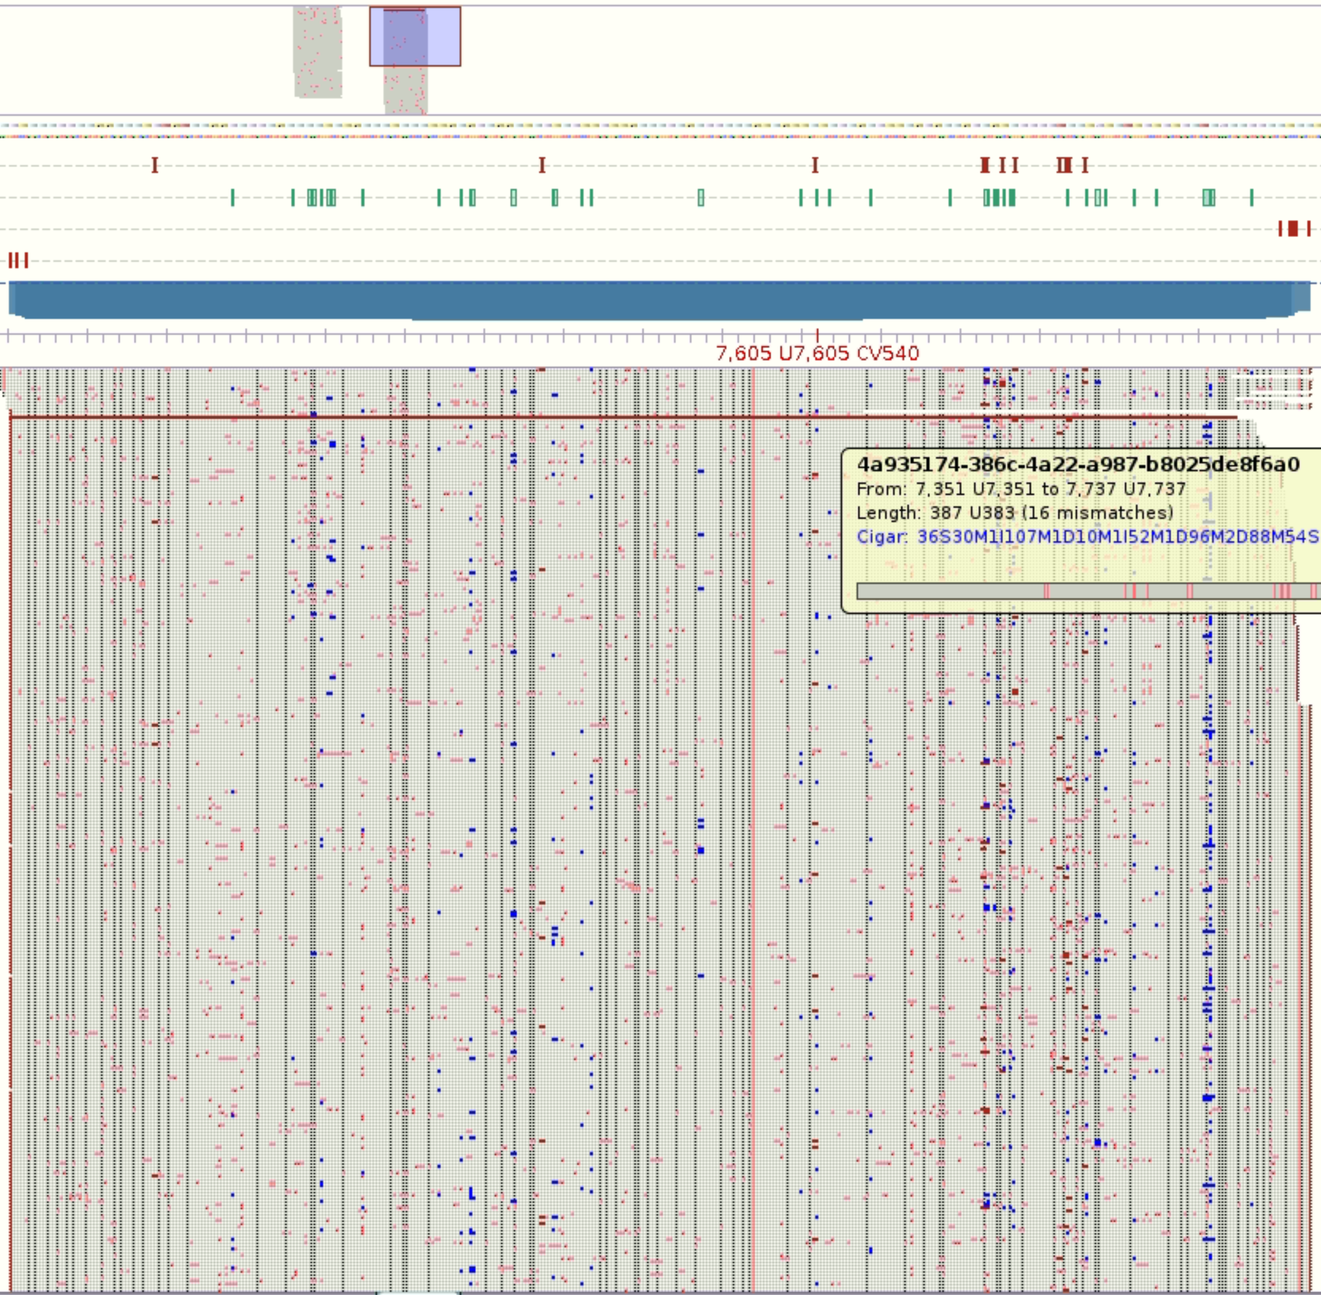
Sequencing errors
Illumina
Nanopore: Guppy
Nanopore: Bonito

Slide 5
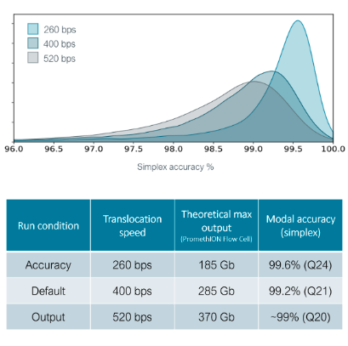
Sequencing errors
The major caveat of nanopore sequencing is the high error rate.
It is a common misconception that nanopore errors are all random; errors occur more frequently I homopolymer regions.
ONT have been working on Q20+ sequencing chemistries, which decrease the sequencing error rate significantly.
Duplex basecalling combines the data from the complementary strand to increase basecall confidence.

Slide 6
Nanopore Sequencing Data Activity
Basecalling
(Dorado)
Sequencing Run Quality Control
Contamination QC
Mapping
Genome analysis
Alignment Visualisation
Coverage and Depth Statistics
Variant Calling
Base call your data, transforming it from squiggle to bases.
Perform quality control on the data, ensuring our data is of sufficient quality for analysis.
Map the reads to a reference genome, producing three genomic alignments of our read sets.
Perform variant calling on each of our alignments.
Visualise the alignment and variant data in the IGV genome browser, to confirm insertion of a floxed PvDBP into the PkDBPα locus and successful DiCre-mediated excision of the floxed region.
Produce coverage plots of each region, which will be used as a figure for your manuscript report.

